Slide 1
Aegis Wing:
An Examination of Adversarial
vs
Reinforcement Learning Agents
By
Ramzi Adil, Daniel Varivoda, Jose Lou

Slide 2
Agenda
Introduction
What is Aegis Wing
Analysis
Game Model
Agents
ExpectiMax
Reinforcement Learning
Conclusion
Summary
Areas of growth

Slide 3
Introduction
- Our study focuses on the performance of the learning algorithms expectimax and deep q-learning on dynamic and complex states where new enemy agents could appear at any time.
- This is different than traditional games like chess where new pieces do not return after they have been captured.
- We wanted to learn about the behaviors of agents implementing these algorithms and compare them to each other using the same model/environment.
- Empirical study was conducted through the lens of a game called Aegis Wing.

Slide 4

What is Aegis Wing?
Genre: Scrolling shooter video game
Release Date: May 16, 2007
Platform: Xbox 360

Slide 5
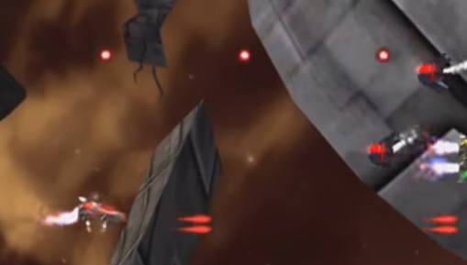
What is Aegis Wing?
Objective:
Players control ships against alien invaders.
Players must survive to the end of the level.
In order to survive, players can destroy enemy ships and avoiding to colliding with enemy ships or their projectiles, in the backdrop of a left-scrolling view.

Slide 6
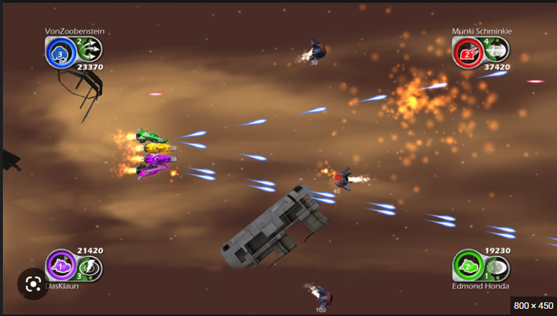
What is Aegis Wing?
Objective:
Stage -> Fixed map with certain number of enemies with varying behaviors

Slide 7
How do you win?
Win = player ship survives until the end point of the given map/stage
Lose = player loses all lives from colliding with enemy ships, enemy projectiles, or mines in a particular stage

Slide 8
Analysis
What is this study about?
- Games are a classical tool used to test the capabilities of AI
- Our study aims to explore expectimax and deep learning on dynamic states using the game model of "Aegis Wing".
How did we do it?
- Made a Game Model
- Applied expectimax and deep learning algorithms which dictate player agent behavior
Our Expectations
- We expect expectimax to comparatively perform worse due to computational limitations
- We expect the deep learning agent to improve until competency

Slide 9
Modeling the Game
Codebase: built in python
Model:
- Environment: The fixed map with boundaries. Contains info on the position of each existing agent.
- Agents: Player ship, Enemy Ships, Projectiles
- Actions: Movement in the 4 basic directions; up, down, left, right, and Fire Action

Slide 10
Agents
1. Player Agent
2. SimpleGoLeft – Only moves left at every turn
3. BasicMoveAndFire – Stochastic policy chooses from uniform distribution of actions.
4. BasicCounter – moves to ideal position, stays and fires for a duration of time, then takes the left action
5. Heuristic Agent – Chases the player and fires if player is in the same row.

Slide 11
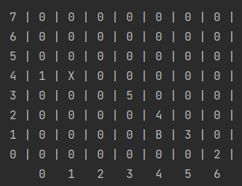
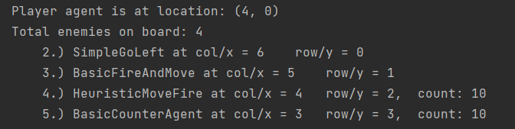
Viewing The Game
Player = 1 at x = 0, y = 4

Slide 12
Our Game Model Configuration
Specific Spawn Rates and Actions
- HeuristicAgent; 15%; Chases and attempts to shoot down player
- CounterAgent; 20%; Fires from a location for a set amount of turns
- BasicFireAndMoveAgent; 20%; Random Action
- SimpleGoLeftAgent; 45%; Only moves left
- Player hp = 3
- Player live(s) = 1
- Turns to survive = 300
- Max Enemies at any given time = 5
- General Spawn Rate = 50%

Slide 13
Scoring Logic
+1 Point per turn
Agent point attribute:
Go Left Agent + 10 points
Basic Counter Agent + 20 points
Fire and Move Agent + 25 points
Heuristic Agent + 50 points
Winning + 10,000 points
Losing - 1,000
-100 points for losing a hp

Slide 14
Player Agent Algorithms
1. ExpectiMax
2. Reinforcement Learning

Slide 15
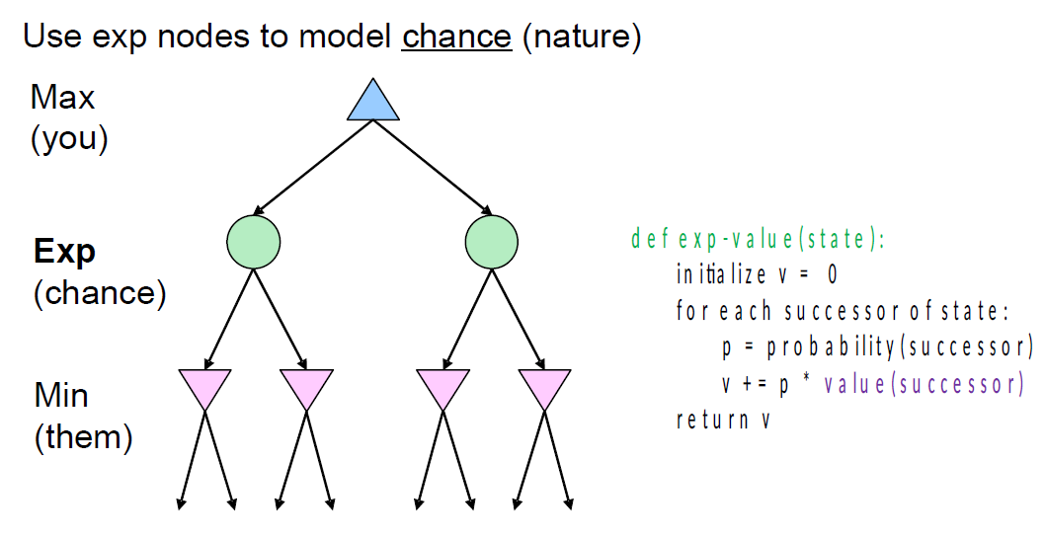
ExpectiMax
A game theory algorithm
Objective: maximize expected utility
Variation of MiniMax
- Difference in assumptions
- MiniMax = Assumes agents play optimally
- ExpectiMax = Assumes enemy agents may or may not play optimally so results are averaged and weighted

Slide 16
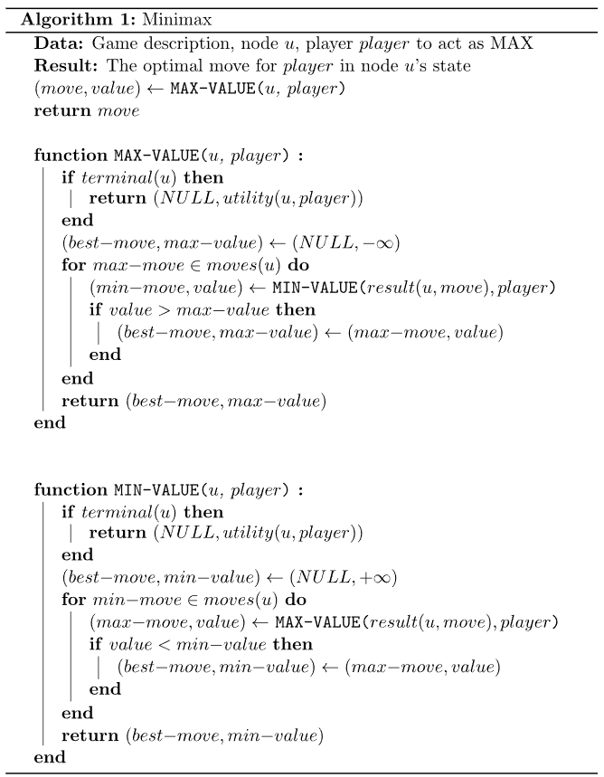
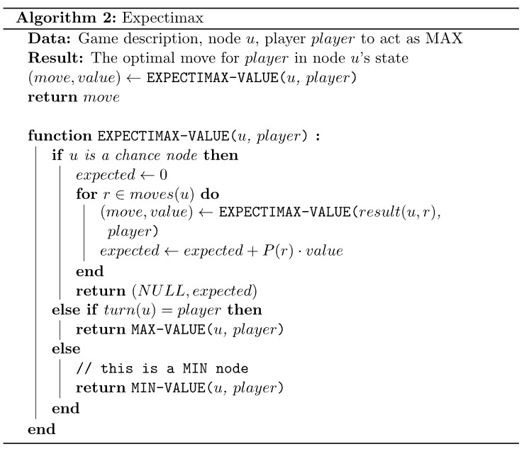
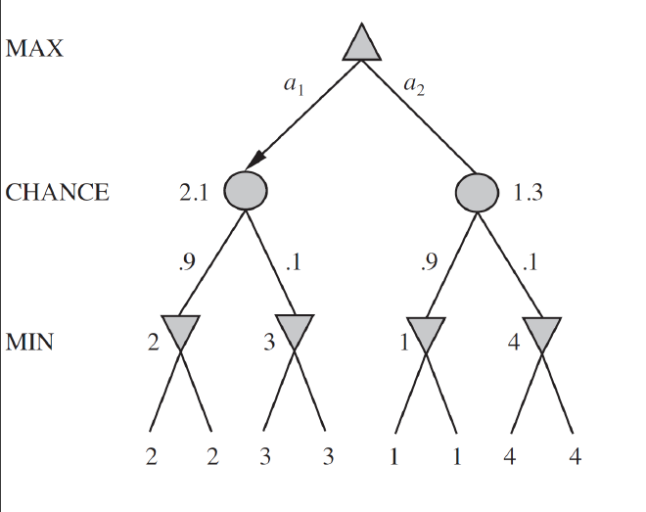
ExpectiMax

Slide 17
Expectimax Agent Results at different depths
Search Depth | Mean Score | SD Score | Mean Turns | Mean Enemies Killed | SD Killed | Games Won | Games Lost | Mean HP Loss on Win | Mean Run Time (Minutes)
Depth 1 | 10373 | 48.46 | 300 | 9.2 | 4.59 | 50 | 0 | 0.1 | 0.02
Depth 2 | 10423 | 54.93 | 300 | 14.96 | 5.46 | 50 | 0 | 0.18 | 0.10
Depth 3 | 10484 | 69.84 | 300 | 20.9 | 6.51 | 50 | 0 | 0.18 | 0.92

Slide 18
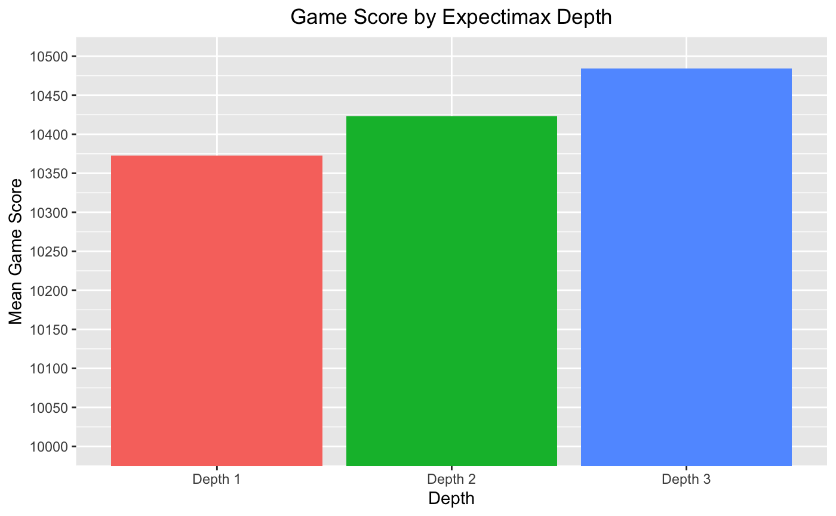
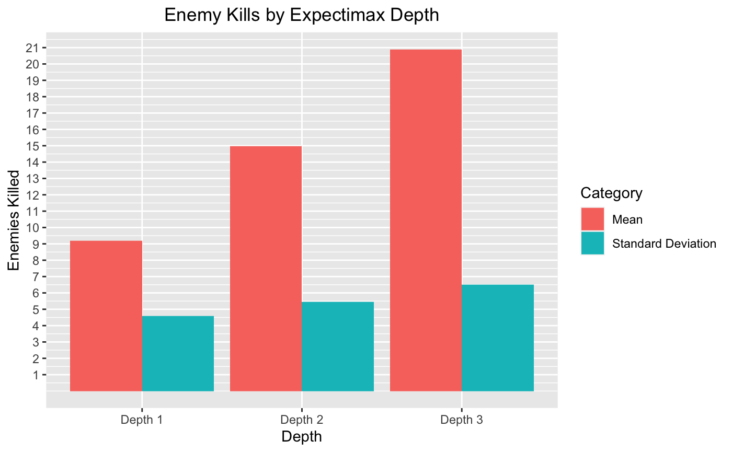
Expectimax Agent Results

Slide 19
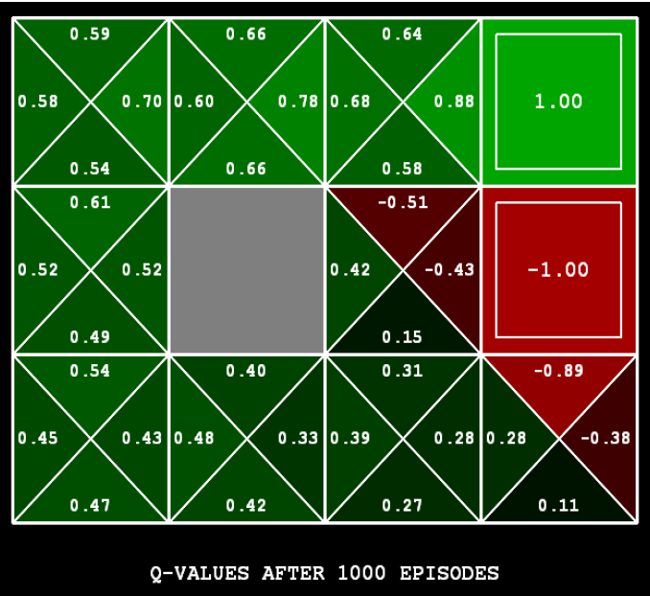
Q Learning
A model-free reinforcement learning algorithm
Objective: learn the value of actions in the particular state
Model-free – can handle problems with stochastic transitions and rewards without requiring adaptations

Slide 20

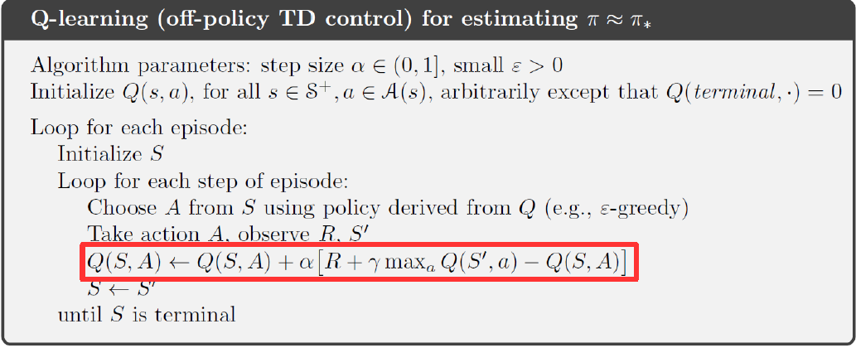
Q Learning

Slide 21
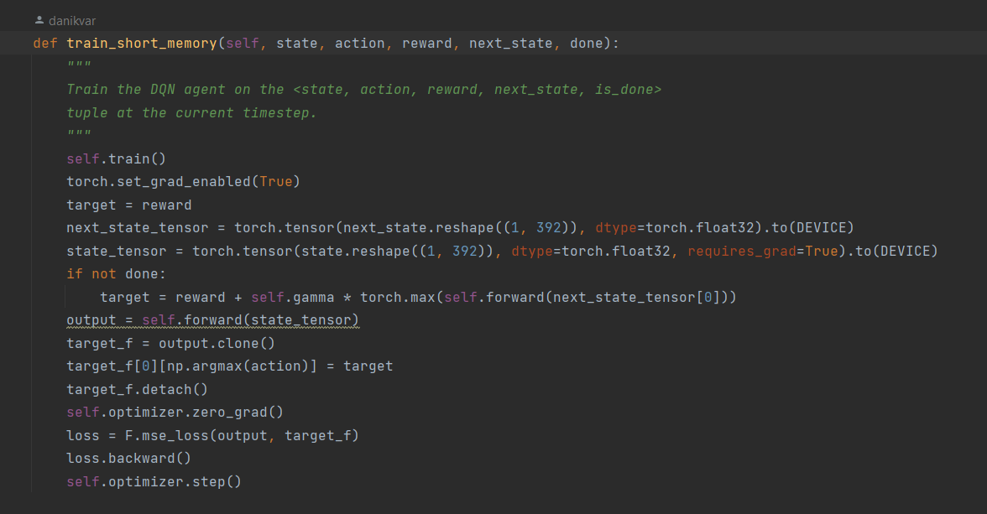
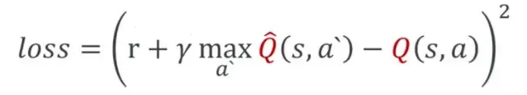
Our Reinforcement Learning Agent
Deep Q-Learning with 4 layer network (2 hidden layers)
8x7x7 Input layer vector encoding positions
6x1 output vector of Q-Values for actions
Heuristic Rewards based on turns survived, enemies posing a threat, enemies killed, and losing/winning
MSE Q Learning Loss Function:

Slide 22
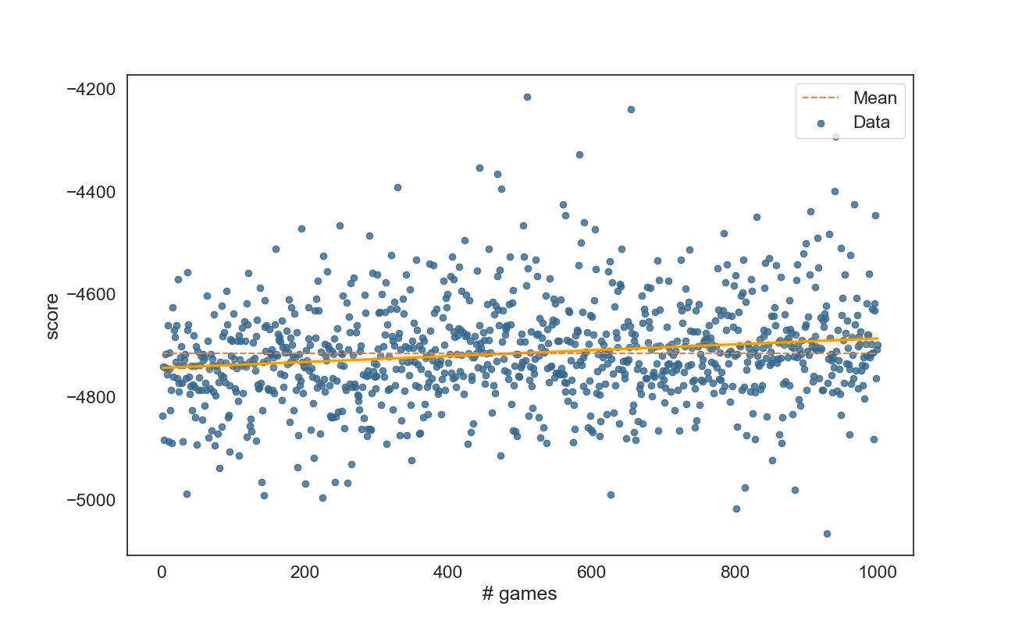
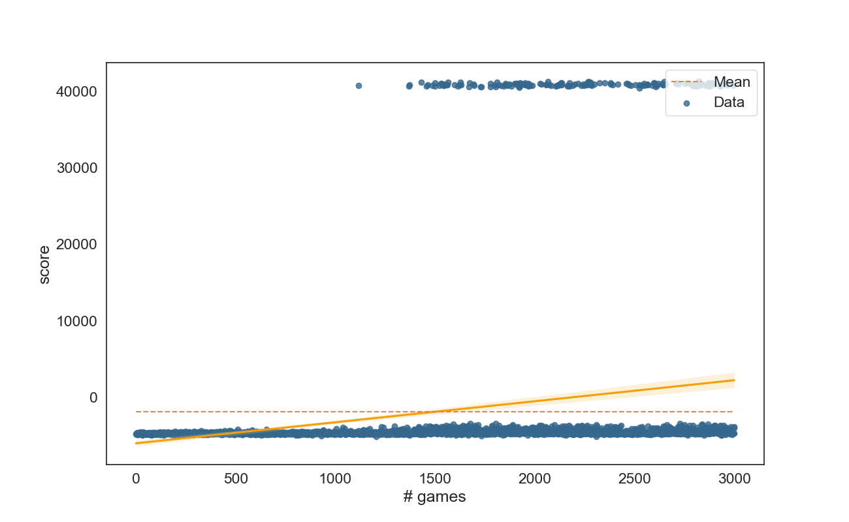
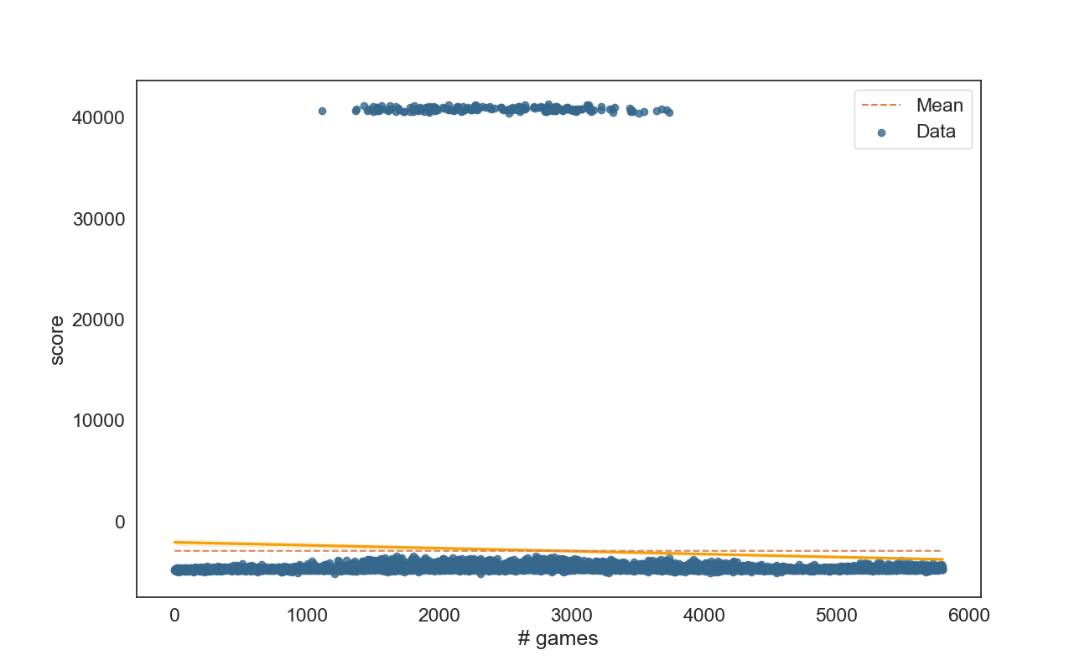
Our Reinforcement Learning Agent: Training

Slide 23
Expectimax vs RL Results
Model | Mean Score | SD Score | Mean Turns | SD Turns | Mean Killed | SD Killed | Num Won | Num Lost | Mean HP Loss on Win | Mean Run Time
Expectimax | -95.92 | 4974.69 | 170.80 | 92.63 | 9.54 | 5.74 | 9 | 41 | 1.78 | 3.71
NN 100 Training Runs | -5736.68 | 62.51 | 27.32 | 18.97 | 2.88 | 1.35 | 0 | 50 | NA | 0
NN 1000 Training Runs | -4743.00 | 3834.57 | 54.44 | 66.58 | 3.50 | 1.99 | 3 | 47 | 1 | 0
NN 2000 Training Runs | -245.80 | 7682.79 | 124.86 | 127.81 | 5.00 | 2.68 | 17 | 33 | 0.82 | 0
NN 3000 Training Runs | 4564.24 | 7785.66 | 203.90 | 130.46 | 6.30 | 2.92 | 32 | 18 | 0.94 | 0
NN 4000 Training Runs | -3448.14 | 5609.37 | 79.12 | 94.38 | 3.74 | 2.74 | 7 | 43 | 1.43 | 0
NN 5000 Training Runs | -5705.08 | 70.83 | 42.62 | 25.04 | 2.60 | 1.63 | 0 | 50 | NA | 0

Slide 24
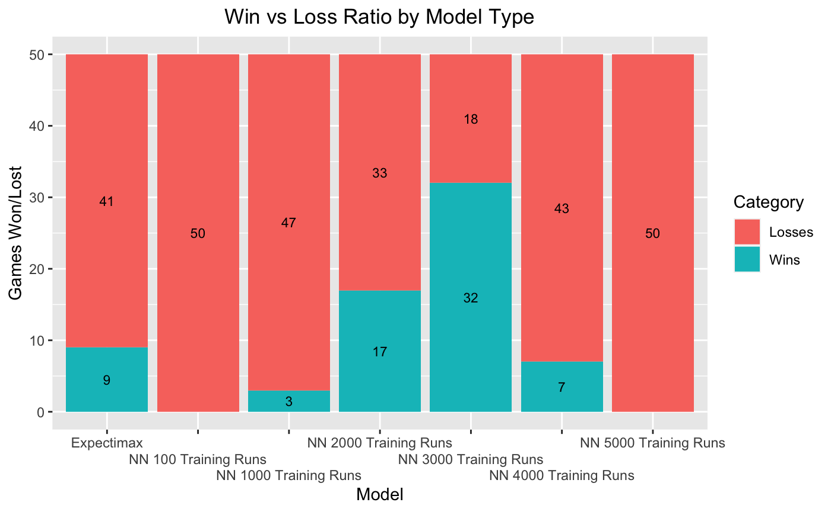
Expectimax vs RL Results

Slide 25
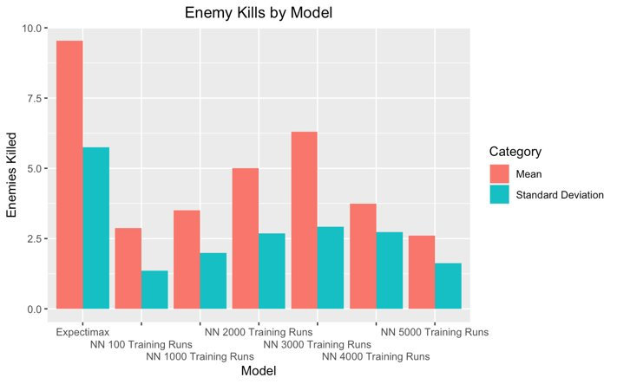
Expectimax vs RL Results

Slide 26
Conclusion
As expected, Expectimax becomes exponentially more difficult to compute with each increase in depth or state space, though it performed surprisingly well at a depth of 1.
While training for the Deep Q-learning network required time and resources, it performed remarkably well with almost no hyperparameter tuning and a basic network structure.
The RL agent is able to compute the state space and decide on actions incredibly fast, showing why deep NNs are at the forefront of dynamic task solving.

Slide 27
Future Studies & Areas of growth
- Creating a good UI/ view to more easily observe agent behavior
- Future studies can compare expectimax and RL agents with at varying expectimax depths.
- Add more complex agents with more complex behaviors
- Applying Hyperparameter optimization on deep-learning agents
- Applying Tree pruning algorithms or other tree based algorithms like Monte-Carlo Tree Search
- Modifying heuristic reward functions and observing agent behavior

Slide 28
Thank you

